Slide 1
OPTIMAL CHOICE

Slide 2
Introduction
We will put together the budget set and the theory of preferences in order to examine the optimal choice of consumers. We said earlier that the economic model of consumer choice is that people choose the best bundle they can afford.
We can now say that consumers choose the most preferred bundle from their budget sets.

Slide 3
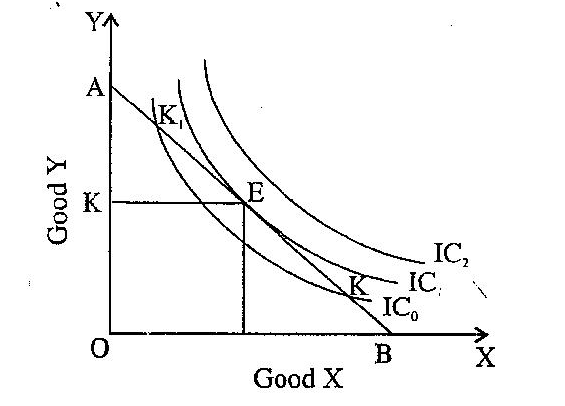
Optimal choice
Simply start at the right-hand corner of the budget line and move to the left. As we move along the budget line we note that we are moving to higher and higher indifference curves. We stop when we get to the highest indifference curve that just touches the budget line.

Slide 4
At this choice, the indifference curve is tangent to the budget line. If you think about it a moment you’ll see that this has to be the case: if the indifference curve weren’t tangent, it would cross the budget line, and if it crossed the budget line, there would be some nearby point on the budget line that lies above the indifference curve—which means that we couldn’t have started at an optimal bundle.
Thus, the consumer chooses consumption of the two goods so that the marginal rate of substitution equals the relative price.
The relative price is the rate at which the market is willing to trade one good for the other, whereas the marginal rate of substitution is the rate at which the consumer is willing to trade one good for the other. At the consumer’s optimum, the consumer’s valuation of the two goods (as measured by the marginal rate of substitution) equals the market’s valuation (as measured by the relative price).

Slide 5
Boundary optimum

Slide 6
If the optimal choice involves consuming some of both goods—so that it is an interior optimum—then necessarily the indifference curve will be tangent to the budget line. But is the tangency condition a sufficient condition for a bundle to be optimal? If we find a bundle where the indifference curve is tangent to the budget line, can we be sure we have an optimal choice?
In the following figure, we have three bundles where the tangency condition is satisfied, all of them interior, but only two of them are optimal. So in general, the tangency condition is only a necessary condition for optimality, not a sufficient condition.

Slide 7
More than one tangency

Slide 8
However, there is one important case where it is sufficient: the case of convex preferences. In the case of convex preferences, any point that satisfies the tangency condition must be an optimal point. This is clear geometrically: since convex indifference curves must curve away from the budget line, they can’t bend back to touch it again.

Slide 9
Consumer Demand
The optimal choice of goods 1 and 2 at some set of prices and income is called the consumer’s demanded bundle. In general when prices and income change, the consumer’s optimal choice will change. The demand function is the function that relates the optimal choice—the quantities demanded—to the different values of prices and incomes.
We will write the demand functions as depending on both prices and income: x₁(p₁, p₂,m) and x₂(p₁, p₂,m). For each different set of prices and income, there will be a different combination of goods that is the optimal choice of the consumer. Different preferences will lead to different demand functions.

Slide 10
For perfect substitutes, have three possible cases. If p₂ > p₁, then the optimal bundle is where the consumer spends all of his or her money on good 1. Here, the slope of the budget line is flatter than the slope of the indifference curves.
If p₁ > p₂, then the consumer purchases only good 2. Finally, if p₁ = p₂, there is a whole range of optimal choices—any amount of goods 1 and 2 that satisfies the budget constraint is optimal in this case.
All they say is that if two goods are perfect substitutes, then a consumer will purchase the cheaper one. If both goods have the same price, then the consumer doesn’t care which one he or she purchases.

Slide 12
In the case of perfect complements, the optimal choice must always lie on the diagonal, where the consumer is purchasing equal amounts of both goods, no matter what the prices are.
The demand function for the optimal choice here is quite intuitive. Since the two goods are always consumed together, it is just as if the consumer were spending all of her money on a single good that had a price of p₁+p₂.
In the case of a neutral good the consumer spends all of her money on the good she likes and doesn’t purchase any of the neutral good. The same thing happens if one commodity is a bad. Thus, if commodity 1 is a good and commodity 2 is a bad, then the demand functions will be
x₁ = m/ p₁
x₂ = 0

Slide 14
Concave preferences
The optimal choice for these preferences is always going to be a boundary choice, like bundle Z. Think of what nonconvex preferences mean. If you have money to purchase ice cream and olives, and you don’t like to consume them together, you’ll spend all of your money on one or the other.

Slide 16
Implications of MRS condition
In well-organized markets, it is typical that everyone faces roughly the same prices for goods. Take, for example, two goods like butter and milk. If everyone faces the same prices for butter and milk, and everyone is optimizing, and everyone is at an interior solution, then everyone must have the same marginal rate of substitution for butter and milk.
The market is offering everyone the same rate of exchange for butter and milk, and everyone is adjusting their consumption of the goods until their own “internal” marginal valuation of the two goods equals the market’s “external” valuation of the two goods.

Slide 17
People may value their total consumption of the two goods very differently. Some people may be consuming a lot of butter and a little milk, and some may be doing the reverse. Some wealthy people may be consuming a lot of milk and a lot of butter while other people may be consuming just a little of each good. But everyone who is consuming the two goods must have the same marginal rate of substitution.
Since prices measure the rate at which people are just willing to substitute one good for another, they can be used to value policy proposals that involve making changes in consumption. The fact that prices are not arbitrary numbers but reflect how people value things on the margin is one of the most fundamental and important ideas in economics.

Slide 18
Choosing taxes
A quantity tax is a tax on the amount consumed of a good, like a gasoline tax of 15 cents per gallon. An income tax is just a tax on income. If the government wants to raise a certain amount of revenue, is it better to raise it via a quantity tax or an income tax?
The income tax is definitely superior to the quantity tax in the sense that you can raise the same amount of revenue from a consumer and still leave him or her better off under the income tax than under the quantity tax.
This is a nice result, and worth remembering, but it is also worthwhile understanding its limitations. First, it only applies to one consumer. The argument shows that for any given consumer there is an income tax that will raise as much money from that consumer as a quantity tax and leave him or her better off. But the amount of that income tax will typically differ from person to person. So a uniform income tax for all consumers is not necessarily better than a uniform quantity tax for all consumers.

Slide 20
Second, we have assumed that when we impose the tax on income the consumer’s income doesn’t change. We have assumed that the income tax is basically a lump sum tax—one that just changes the amount of money a consumer has to spend but doesn’t affect any choices he has to make.
Third. we have totally left out the supply response to the tax. We’ve shown how demand responds to the tax change, but supply will respond too, and a complete analysis would take those changes into account as well.

